Slide 1

ENTRANCE DAY
2025
WELCOME
Tuesday, November 25, 2025
GRISOLI Amphitheatre
UFR des Sciences Médicales et Paramédicales - Rez de Chaussée - Aile verte
Compulsory for 1st years

Slide 2
09h00 - Presentation of the Biomedical Research Doctoral School - ED659 :
Frédéric CASTINETTI - Doctoral School Director et Julie BERBIS - Deputy Director of the Doctoral School
09:20 - Clinical research : Noémie JOURDE-CHICHE – Direction Recherche Clinique AP-HM
09h35 - Clinical Investigation Center : Thomas CUNY - Director
09:50 - Hippo'Thèses doctoral students' association : Meryem Alaka, President and Angélique BERTHOME, Member
10h00 – Cancéropole : Clara DUCORD
10h15 - AMU Scientific Culture Unit : Florence LISLE - AMU
10h30 - Association TOUS CHERCHEURS : Magali CONESA - Member of the Association
10h45 - PÉPITES PROVENCE network : Jean-Luc THOLOZAN
11h00 - SATT Sud Est : Florence ALESANDRINI
11h15 - Phd Program NEUROSCHOOL : Isabelle VIRARD – Project Manager
11h35 - PhD Program ICI - INSTITUT CANCER IMMUNO : Marie-Dominique FRANCO - Project Manager
11h55 - PhD Program MarMaRa - INSTITUT MARSEILLE MALADIES RARES : Marie-Cécile GAILLARD - Project manager
12h15 - Any other business

Slide 3
408 HDR
80 defences in 2025
30 Research Units
11 AXES
360 PhD
1 support team
AN INTERCONNECTED DOUBLE PROFILE
Basic research
Translational research
Might be linked to clinical outcomes

Slide 4
Missions
In accordance with the missions assigned to Doctoral Schools by the decree of May 26, 2016, the Biomedical Research Doctoral School ED 659
Organizes the training of doctoral students and prepares them for their professional activity. It supports doctoral students in completing their doctorates, in particular by providing them with a multidisciplinary culture within the framework of a coherent scientific project.
Organizes the allocation of funding, in particular doctoral contracts (14 in 2025).
Ensures the quality of supervision of doctoral students by research units and teams, ensures compliance with the doctoral charter of 06/26/2016, and implements it.
Enables doctoral students to prepare and defend their theses under the best conditions
Organizes follow-up on the professional integration of PhD graduates and, more generally, of all doctoral students enrolled in the doctoral schoolTranslated with DeepL.com (free version)

Slide 5
BASIC INFORMATION
Head of the Doctoral School
  Pr Frédéric CASTINETTI – Director
  Pr Julie BERBIS - Deputy Director
Administrative offices of the Doctoral School
  Nathalie CANIPAROLI - Gestionnaire Ecole Doctorale
  Tél : +33 (O)4 13 94 20 62 - Email: nathalie.caniparoli@univ-amu.fr
Administrative registration for doctorates - Registrar's offices
Administrative registration with the schools to which the laboratories are attached:
Medical and Paramedical Sciences - SMPM
smpm-doctorat-hdr@univ-amu.fr
Stéphanie PRAT(Assistante de Direction)
04 91 32 43 05
Lydie VERNET(Gestionnaire Scolarité)
04 91 32 46 79
Appointments Monday to Thursday, 1.30 pm to 4 pm
Pharmacy
pharmacie-scol-cycle3@univ-amu.fr
04 91 83 56 97
Telephone reception during opening hours
(Mon-Wed-Fri: 10am-1pm; Tues-Thurs: 1pm-4pm)

Slide 6
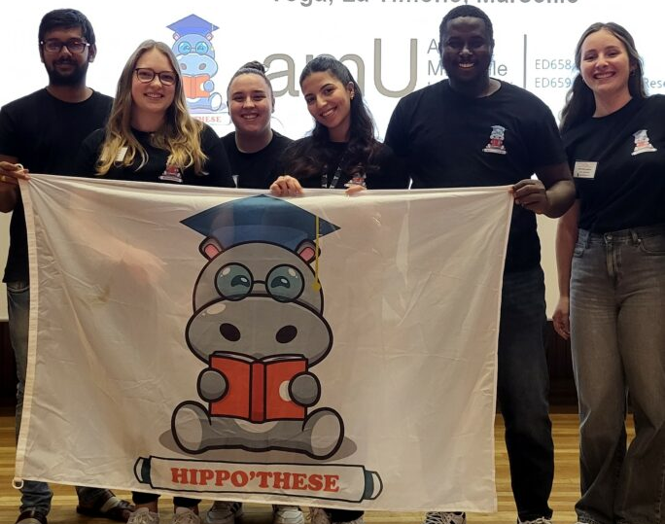

Doctoral student members of Doctoral School Council :
BERTHOMÉ Angélique – C2VN Centre de Recherche en CardioVasculaire et Nutrition
INIDRY Solange CEReSS Centre d’Études et de Recherche sur les Services de Santé et la Qualité de Vie
MORIN Loewa - MMG Marseille Medical Genetics
SOW Aboubacar - C2VN Centre de Recherche en CardioVasculaire et Nutrition
Doctoral associations
HIPPO’THESE
Association des doctorants de l’ED https://hippothese.asso.fr/
DynAMU
Association des doctorants d’Aix-Marseille Université https://dynamu.fr/
JSM3 The Junior Scientists Microbiology Meeting of Marseille https://www.jsm3congress.fr/home

Slide 7
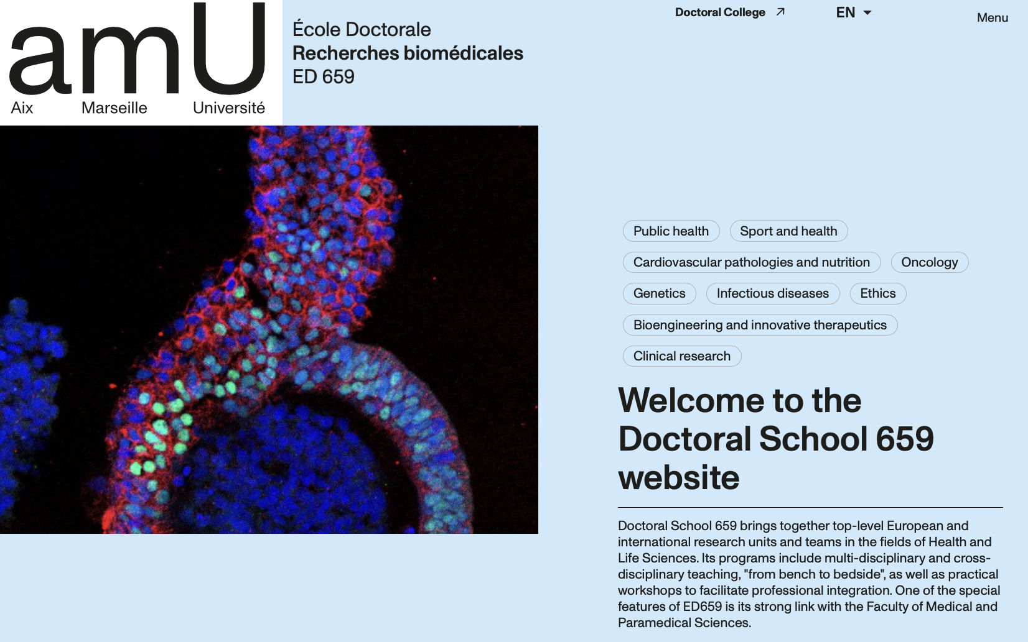
BASIC INFORMATION: Doctoral School website
https://ecole-doctorale-659.univ-amu.fr/en

Slide 8
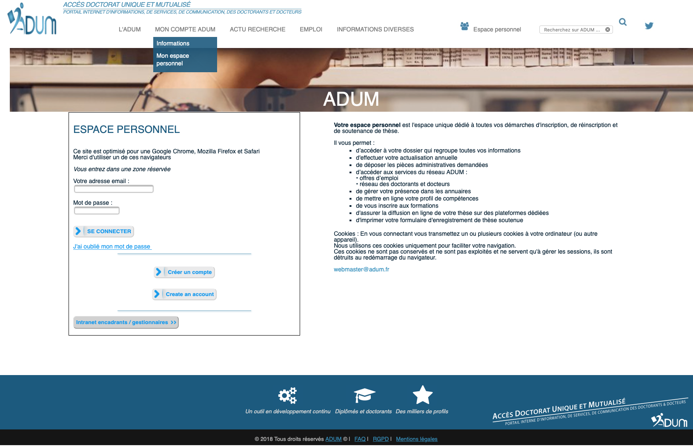
BASIC INFORMATION: ADUM Database website

Slide 9
Biomedical Research specialization
Specialties and laboratories
Ethics, Humanities and health
Genetics
Bioengineering and innovative therapeutics
Infectious diseases
Neurology, imaging and mental health
Oncology
Cardiovascular pathologies and nutrition, inflammation
Clinical research, simulation and paramedical sciences
Public health
Sport and Health
Find a mentor
Find a research Unit
Define a project
Get funding
Identify the specialty

Slide 10
TIMELINE OF A PhD
Symposium ED659 / Faculty of Medicine
CSI
3 compulsory training courses
Year 1
Year 2
Year 3
Year 4… PhD
Individual Thesis committee (CSI)
CSI
Project definition
Literature and Research work
Complete research
Writing up
Submission and Viva
Professionnal & Career Development
Disciplinary & Professional Training

Slide 11
DISCIPLINARY AND TRANSVERSAL TRAINING
A minimum of 3 formations per disciplinary and transversal training programs are required
Informations are on the website ADUM database
Disciplinary training:
Doctoral School - PhD Programs
Professional (transversal) training
Doctoral Collegium – PhD programs
50 Hrs
50 Hrs
At every yearly registration, check your quota of training hours and print it for validation !

Slide 12
DISCIPLINARY AND TRANSVERSAL TRAINING
Special cases
PhDs in joint supervision:
You must validate the same number of training hours, whether they are taught within AMU or within their cotutelle University
PhDs with employment
PhD students practicing in AP-HM or in liberal, will have to validate 50 hours of scientific and / or disciplinary training. Cross-training courses are also, of course, validated.
PhDs with teaching duties
Teaching training organized by CIPE
These trainings are on the SYGEFOR platform
100 Hrs
50 Hrs
58 Hrs

Slide 13
PhD Programs: if your specialty belong to a PhD program, you must be enrolled in it
Organized by laboratories in synergy with the Doctoral School
Eventually supported by external sources of fundings, providing opportunities for student mobility
Providing training, tutored seminars, technological training, all validated by the doctoral school
1
2
3

Slide 14
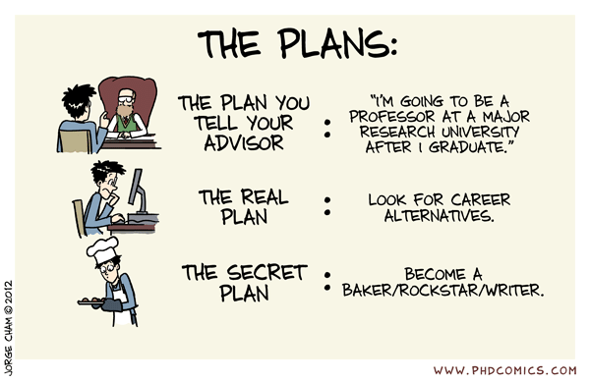
PROFESSIONAL / TRANSVERSAL TRAINING: a career planning
Doctoral School (e.g. teaching innovative methods)
Doctoral Collegium (e.g. Doctoriales, CV, IP, ….)
Laboratories (e.g. Semaine du Cerveau, Sciences et Société, …)
External trainings (e.g. Association Grand Luminy, …)
Minimum 50 hours and 3 training programs per professional and transversal training over the 3 years

Slide 15
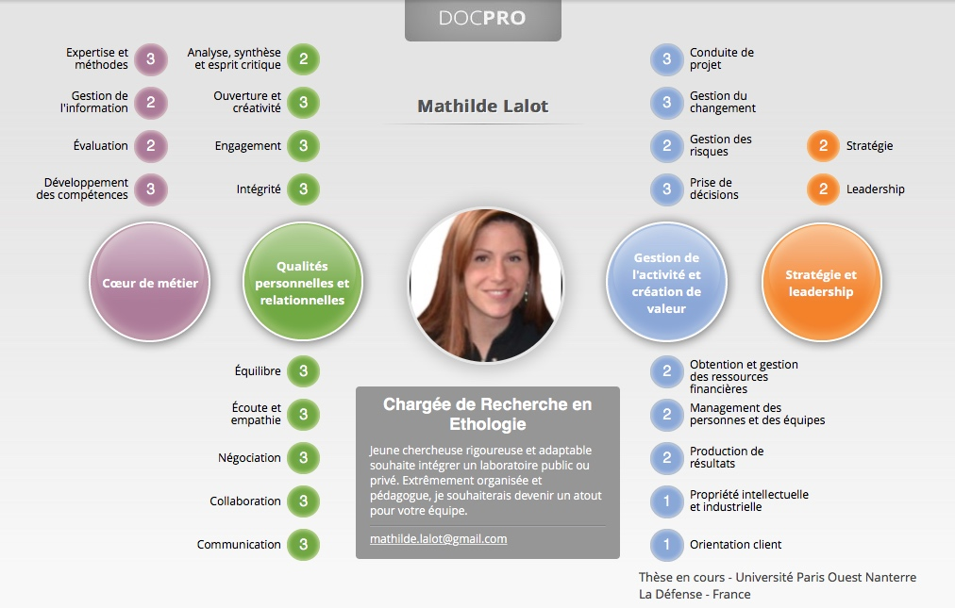
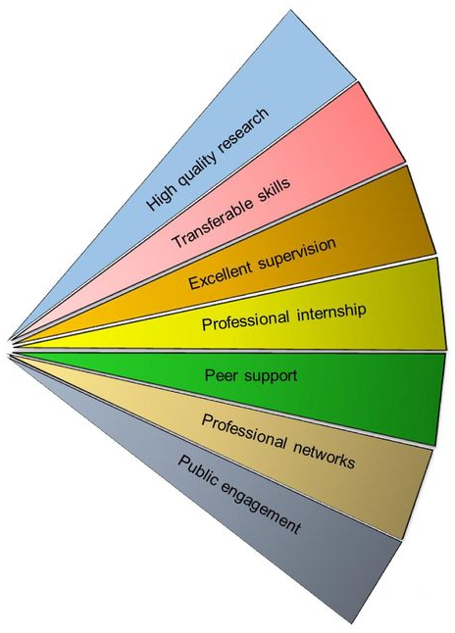
TRANSFERABLE PhD SKILLS: PORTFOLIO
Article 15 - […] Un portfolio du doctorant comprenant la liste individuelle de toutes les activités du doctorant durant sa formation […] et valorisant les compétences qu’il a développées pendant la préparation du doctorat, est réalisé.
http://blog.accompagner-demarche-portfolio.fr

Slide 16


REGISTRATION: EACH YEAR
https://ecole-doctorale-659.univ-amu.fr/en
Program enrollment Step1
Mutual commitment by all those involved in the PhD (PhD student, advisor, research unit and doctoral school)
Individual doctoral training agreement
Doctoral student portfolio
Registration Step 2
Authorization to register (laboratory, supervisor, doctoral school)
Registration fees
Registration in 4th derogatory year
Support letter from your advisor
Additional funding to finish your PhD

Slide 17
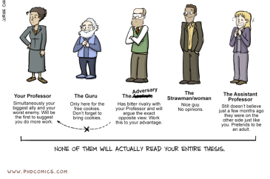
THESIS COMMITTEE (CSI):
Composition: (3 members or more + supervisor)
A thesis committee, what for?
Thesis advisor
Personal tutor
(useful)
Expert
(external and possibly referee of your PhD defense)
Representative of the DS
(from your lab)
PhD or post-doc representative
Roles of your Thesis Committee
1. Follow-up of the thesis work
2. Orientation and advices
3. Screening for difficulties or conflicts
4. Informal discussion with and without your advisor
!! Required to renew your annual registration !!
https://ecole-doctorale-659.univ-amu.fr/en/phd-student/individual-follow-up-committee

Slide 18
OBJECTIVE AT THE END OF 3/4 YEARS: PhD Defense
Requirements for defense
1st author publication (article or patent)
100 hours of training
Mandatory registration (ADUM): 10 weeks before defence
Jury validation : Doctoral school
Gender ratio
External reviewers (« rapporteurs ») with HDR
Minimum of 4 members (at least 50% external)
Defense aproval : Doctoral school

Slide 19

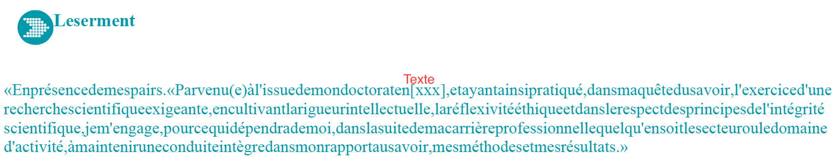
Ph.D. Defense: sermon
« En présence de mes pairs. Parvenu(e) à l’issue de mon doctorat en (domaine de recherche), et ayant ainsi pratiqué, dans ma quête du savoir, l’exercice d’une recherche scientifique exigeante, en cultivant la rigueur intellectuelle, la réflexivité éthique et dans les respects de l’intégrité scientifique, je m’engage, pour ce qui dépendra de moi, dans la suite de ma carrière professionnelle quelqu’en soit le secteur ou le domaine d’activité, à maintenir une conduite intègre dans mon rapport au savoir, mes méthodes et mes résultats. »
« In the presence of my peers. With the completion of my doctorate in (research field), in my quest for knowledge, I have carried out demanding research, demonstrate intellectual rigour, ethical reflection, and respect for the principles of research integrity. As I pursue my professional career, whatever my chosen field, I pladge, to the greatest of my ability, to continue to maintain integrity in my relationship to knowledge, in my methods and my results. »

Slide 20
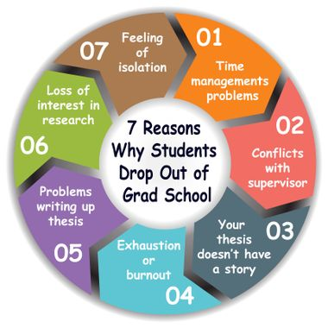
FOLLOW-UP AND TROUBLESHOOTING
Thesis committees
Audition
Report
Survey during symposium
Thesis evolution
Unsatisfied training
Ad hoc committee
In case of major issues
Troubleshooting
DON’T WAIT IF YOU HAVE PROBLEMS, TALK ABOUT IT, CONTACT US !

Slide 21
OBTAINING A Ph.D IS A TEAM WORK
PHD STUDENT
Thesis advisor
PHD THESIS: A GREAT OPPORTUNITY
STAY IN TOUCH WITH THE DOCTORAL SCHOOL
RESPECT YOUR DUTIES AND RIGHTS (« CHARTE DU DOCTORANT »)
DO NOT WAIT IN CASE OF TROUBLE
PREPARE YOUR FUTURE
Support:
Thesis committee
Support:
Doctoral School
Support and Real life:
PhD association

Slide 22
https://ecole-doctorale-659.univ-amu.fr
THANKS FOR YOUR ATTENTION

